Slide 1
Testability Operability Hooks

Slide 2
Query and Control Points
Hooks
Query
Control
Liveness
Readiness

Slide 3
First Class Features
Resistance
Purity of the model
Would cars be built without diagnostic ports?

Slide 4
Focus on API Hooks
Snapshot – the ability to query state quickly and easily
Action – the ability to (re)set state to a known value

Slide 5
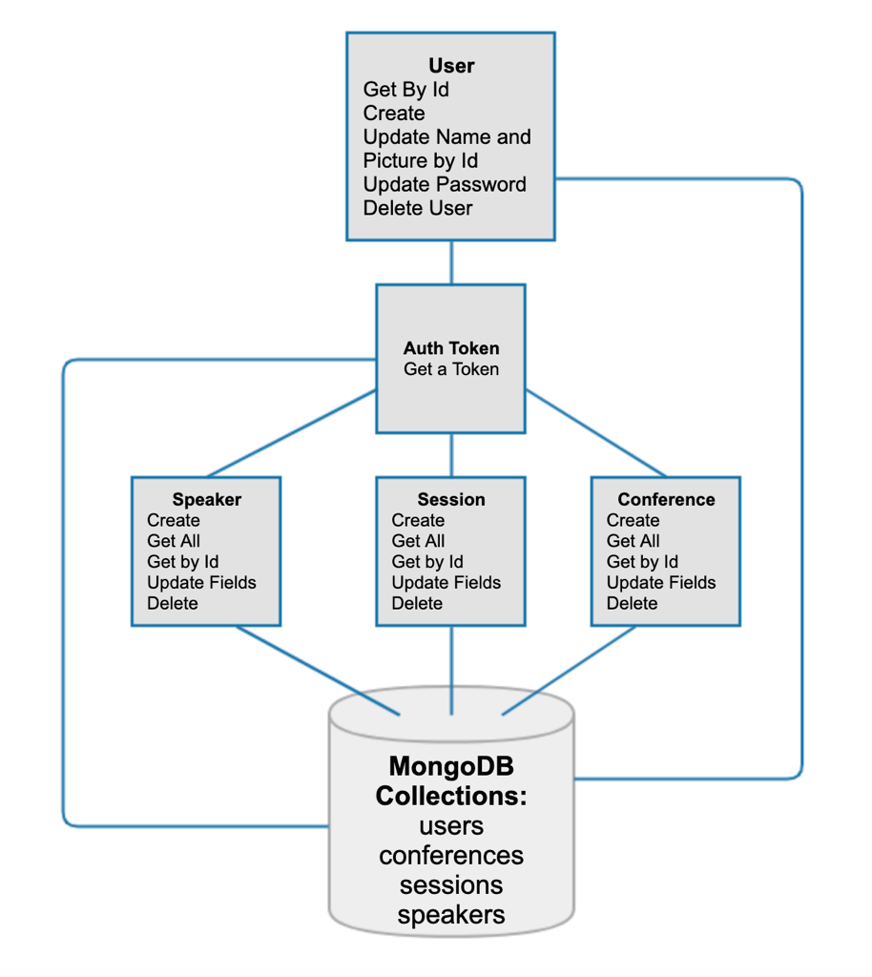
Draw the app
Snapshot hooks
Action hooks
What if the API served a mobile app?

Slide 6
Build a Snapshot Hook!
Start in src/api/index.js
New folder in api/
Basics
Mongo model

Slide 7
What else?
Mongoose docs
What other methods can we use?

Slide 8
Almost there!

